Slide 1

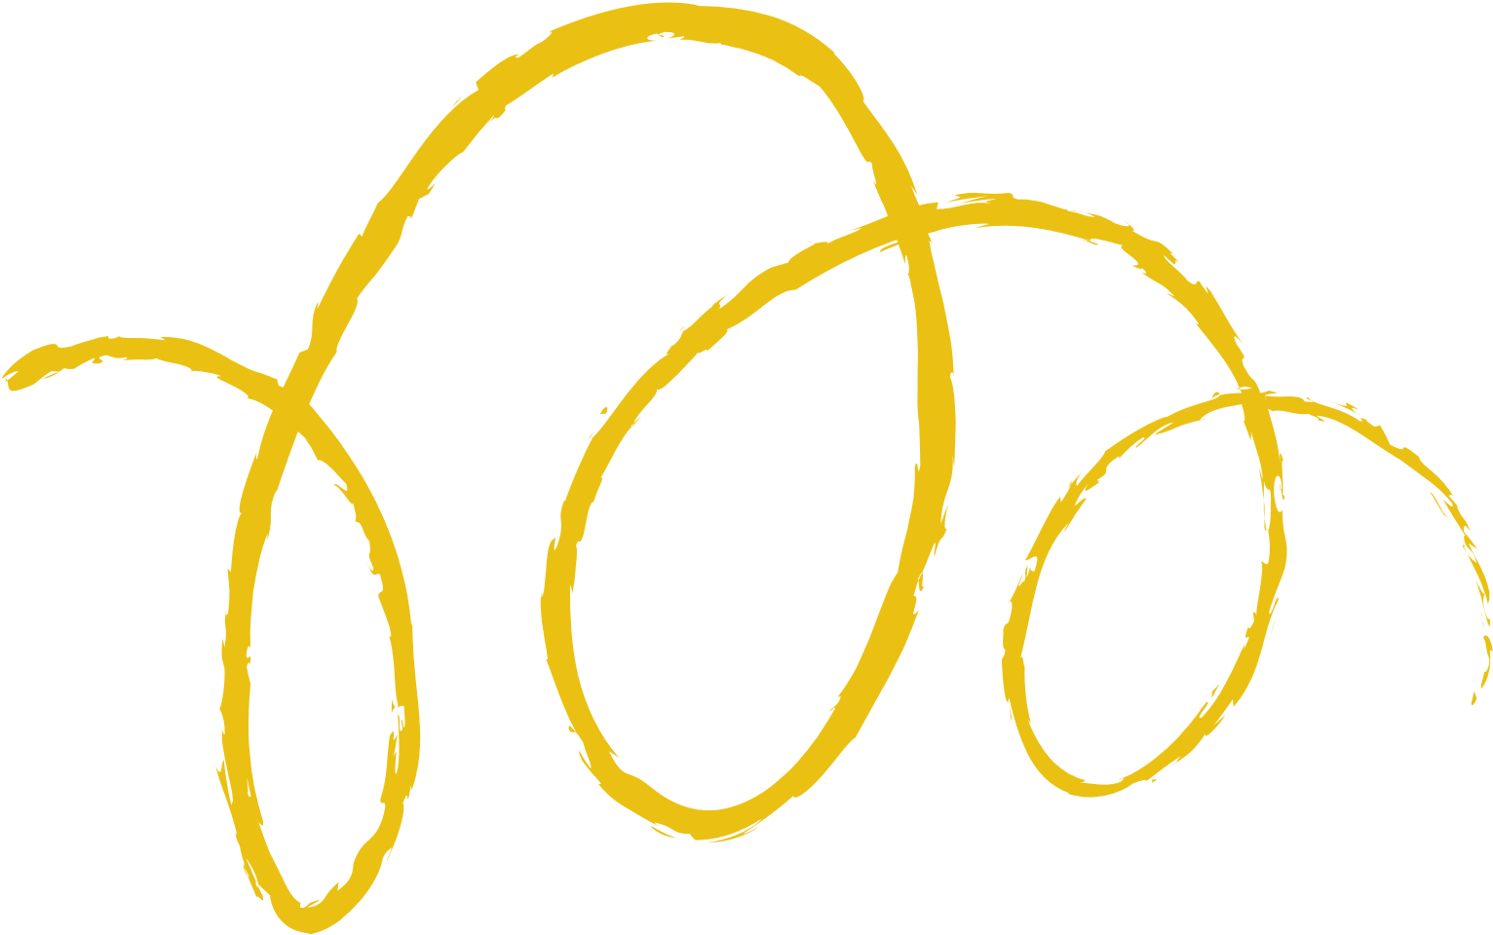






CONTROL
Presented by
Adarsha Shakya
Kritya Shah
Nitin Maharjan
Sarina Maharajan

Slide 2




What is Control?
Primary goal-oriented function of management
Process of comparing the actual performance with the standards of the company
Ensure that activities are performed according to the plans
Taking corrective actions in the given timeline to avoid loss.

Slide 3





Management Function
Continuous Process
Features of Controlling
Dynamic Process
Goal Oriented
Measurable
Comparative
Corrective Action
Pervasive Function

Slide 4



Importance
Improve Efficiency
Maximize Products
Reduce Cost
Coordination
Supervision
Achieve Goal

Slide 5


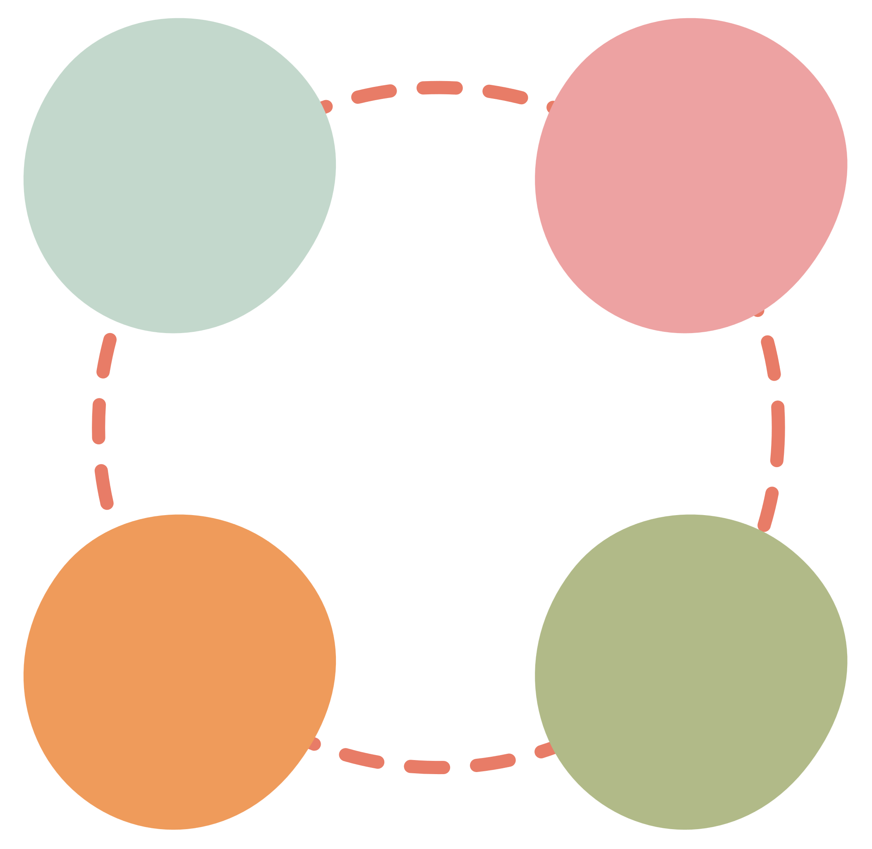

Control
Process
1
2
Measurement of Actual Performance
Determine the basic boundary of the company
Measuring the actual work done according to the standard
Compare the actual work with the standard
Analyze the difference and take actions if necessary
Establishment of Standard
4
3
Analyzing and Taking corrective Action
Comparison of Actual Performance

Slide 6



Type of Control
Pre-Control
Concurrent Control
Feedback Control
Also called feed-forward or preventive control
Helps manager to identify problems and find solution.
Let you prevent problems before their occurrence.
predicts problems that may occur in the future and tries to identify steps to resolve it.
Also called side-by-side or real-time control.
Solving or managing problems as they happen.
Continuous observance is necessary to make activities according to standards.
Identify and analyze as problem occurs and solved immediately.
Also called a post-control system.
Solves problems after they happen.
Identification of whether or not the projects meet the standard.
Managers take the base of past performance to take better future actions.

Slide 7




What is Quality?
Quality refers to the degree of excellence or superiority of a product, service, or process.
It is the the ability of a product or service to meet customer's expectations.
It defines how good something is compared to other similar things.

Slide 8

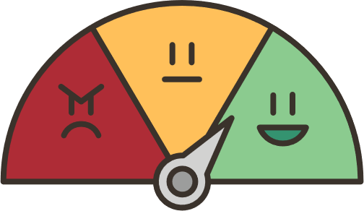
Importance of Quality
To meet the expectations of the customers
To gaining competitive advantage
For the satisfaction of customers
To manage costs effectively
To Reduced risk
To enhance growth in revenues and profits
To build a positive reputation for a business or individual.

Slide 9


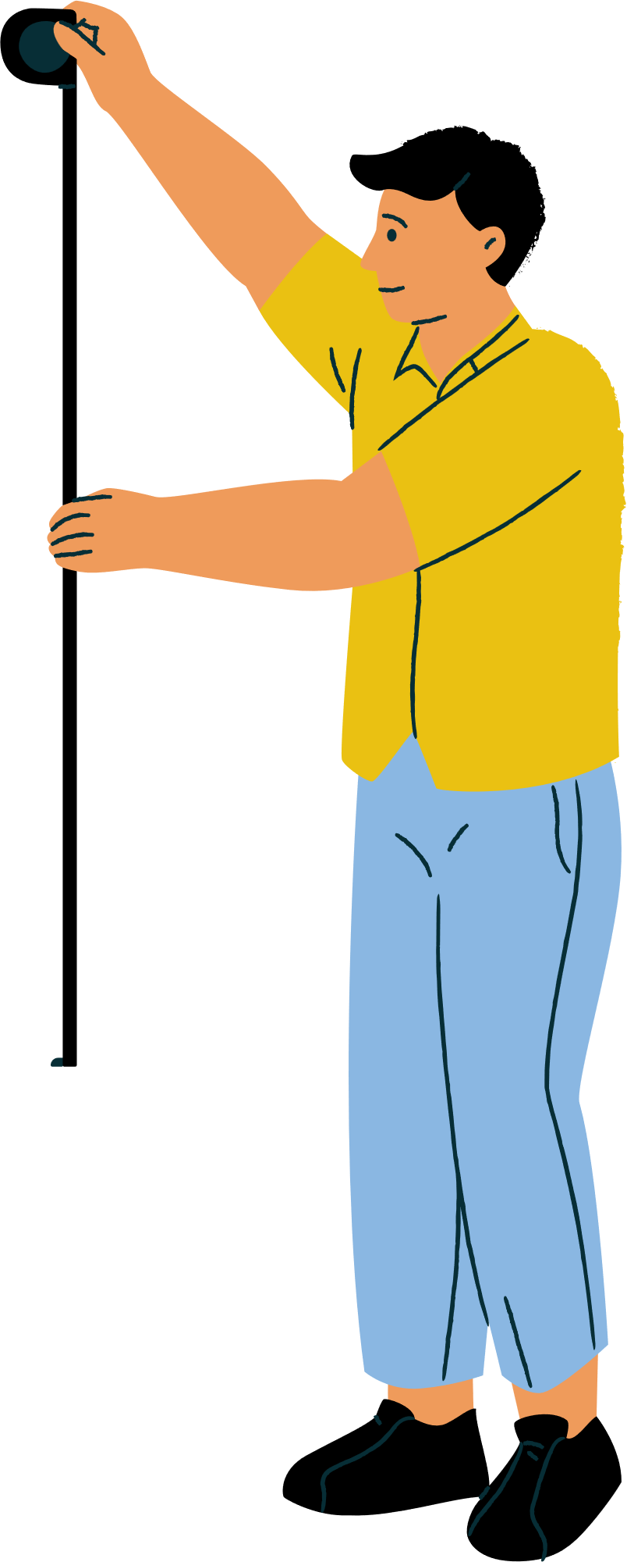
How is Quality Measured?
Quality of a product can be measured on the basis of given factors:
Failure or reject rates
Level of product returns
Customer complaints
Customer satisfaction – usually measured by a survey
Customer loyalty – evident from repeat purchases
The Price-to-Earnings ratio (P/E) is a common valuation metric. A low P/E may suggest a stock is undervalued, while a high P/E could indicate the opposite. However, it's crucial to consider other factors and compare P/E ratios within the same industry for a more accurate assessment of a stock's valuation.

Slide 10



Total Quality Management
An ongoing process of detecting and reducing errors.
Used to improve customer service, and ensure that employees are properly trained.
Focus on improving the quality of an organization's outputs.
Aims to hold all parties involved in the production process.

Slide 11


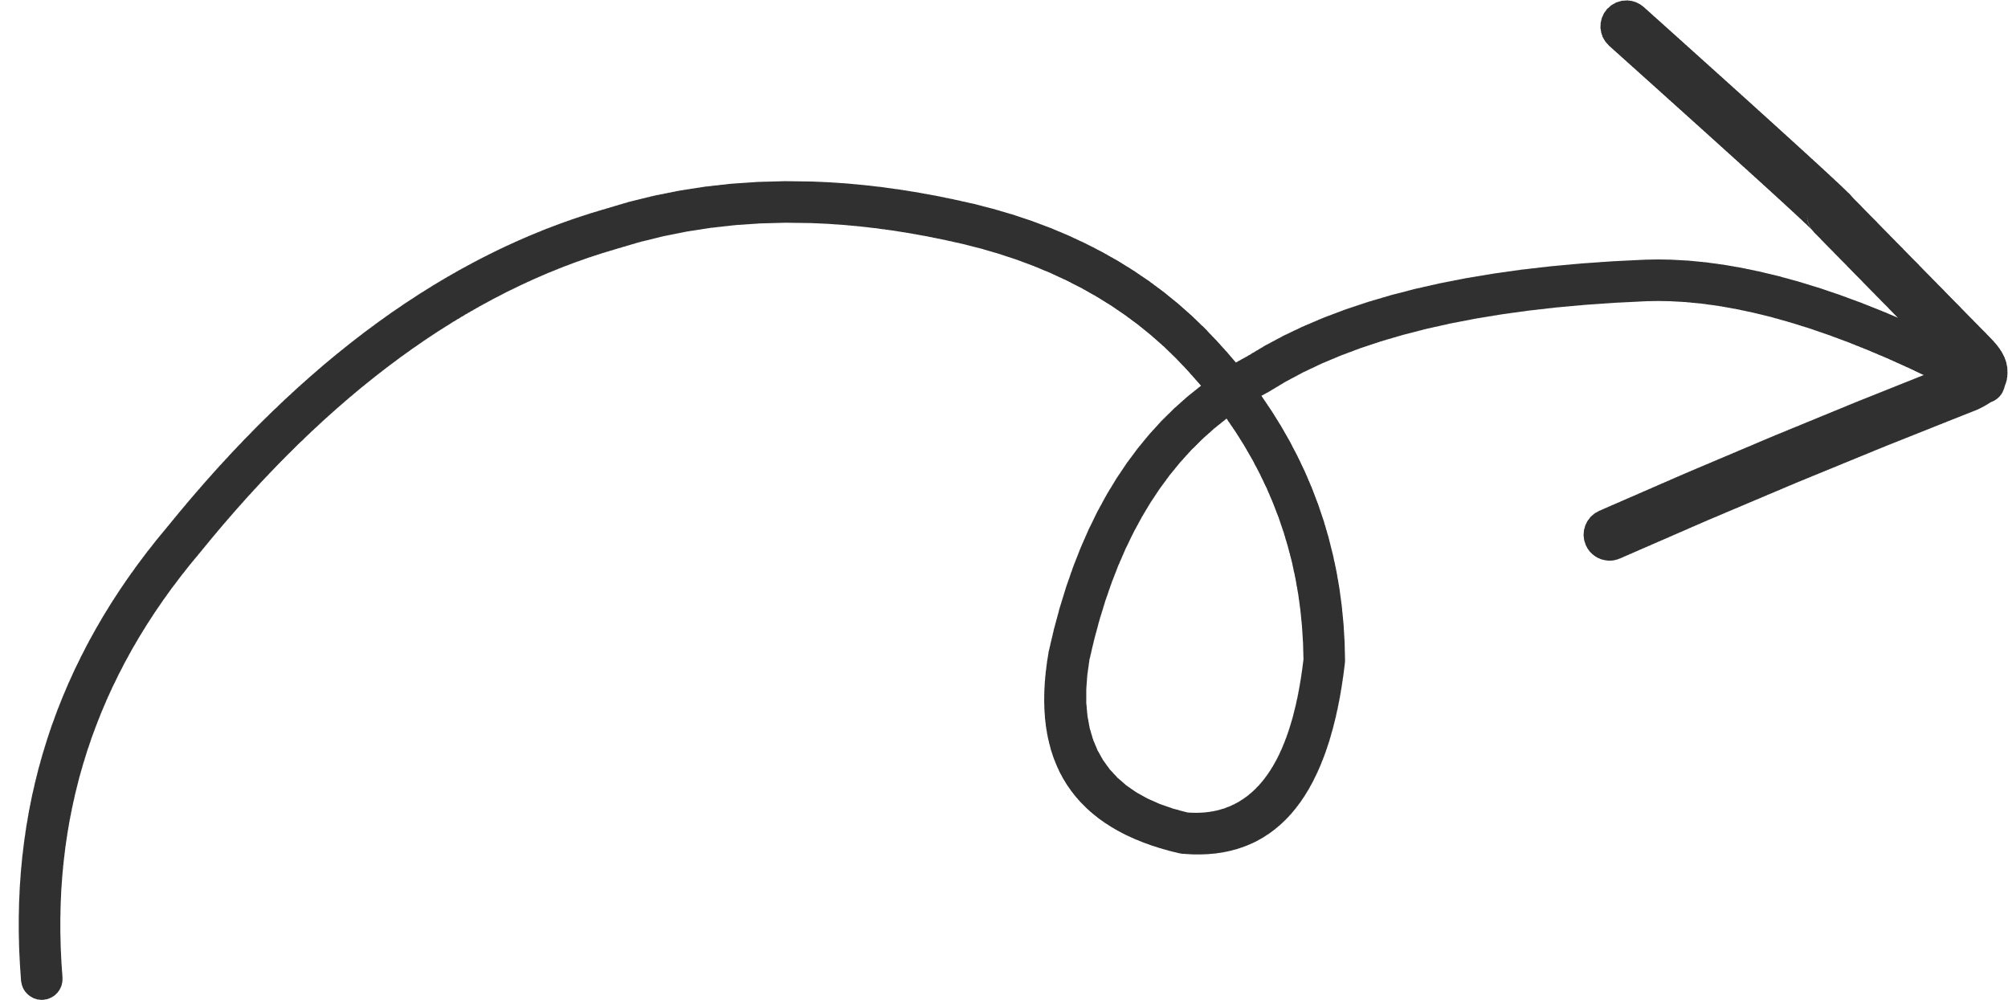




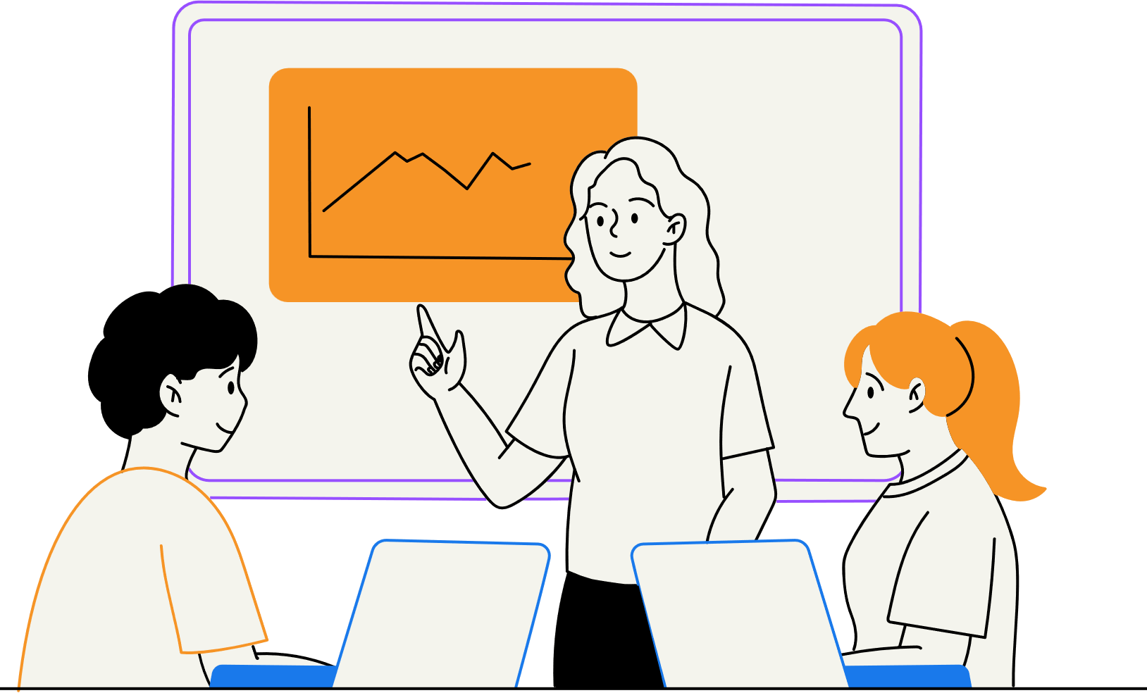
Focus on customer
Commitment by Employees
Strategic and Systematic Approach
Principles
Improve Continuously
of TQM
Data Utilization
Communication

Slide 12




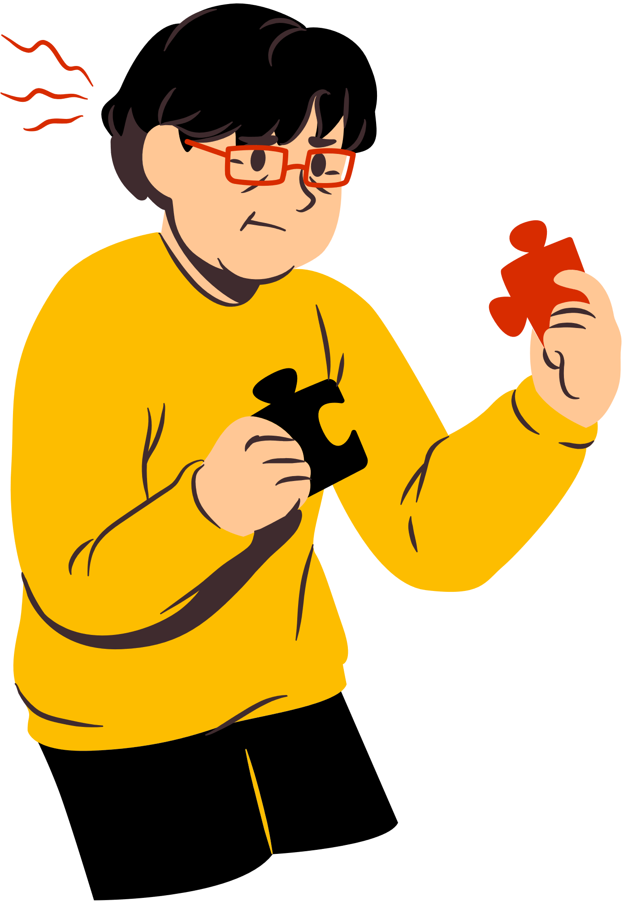


Issues in Total Quality Management
01
02
03
Lack of Commitment by Top Management
Lack of continuous Training and Education
Inadequate use of empowerment and teamwork
04
05
06
Failure to Continuous Improvement
Paying inadequate attention to internal and external Customers
Inability to change organizational culture

Slide 13








THANK YOU

